Slide 1

Bankruptcy Prevention
By Group 5 –
Ramesh Patil
Prasanna Nikam
Rachit Kumar Singh
Shubham Gagare
Anuradha Adsul
<Mentor – Karthik Muskula>
<02/11/2023>

Slide 2
Business Problem:
How can we use machine learning to predict the probability of bankruptcy for a business?
What are the most important features that contribute to bankruptcy?
Objective:
To model the probability that a business goes bankrupt from different features.
Dataset has 7 features about 250 companies, including industrial risk, management risk, financial flexibility, credibility, competitiveness, operating risk, and class (bankruptcy or non-bankruptcy).

Slide 3
Project Architecture / Project Flow
Import libraries and dataset.
Cleaning data and EDA
Model Building
Model Predictions & Results
Model deployment

Slide 4
Project Architecture / Project Flow
Data collection and preparation:
(i) Import data from relevant sources, such as financial flexibility, credibility reports, management risks etc.
(ii) Clean and prepare the data for modeling, including removing outliers and handling missing values.
Model training and evaluation:
(i) Train different machine learning models on the prepared data.
(ii) Evaluate the performance of the models on a held-out test set.
(iii) Select the best performing model for deployment.
Model deployment:
(i) Deploy the selected model to a production environment so that it can be used to predict bankruptcy risk for new businesses.
(ii) Monitor the performance of the model in production and make adjustments as needed.

Slide 5
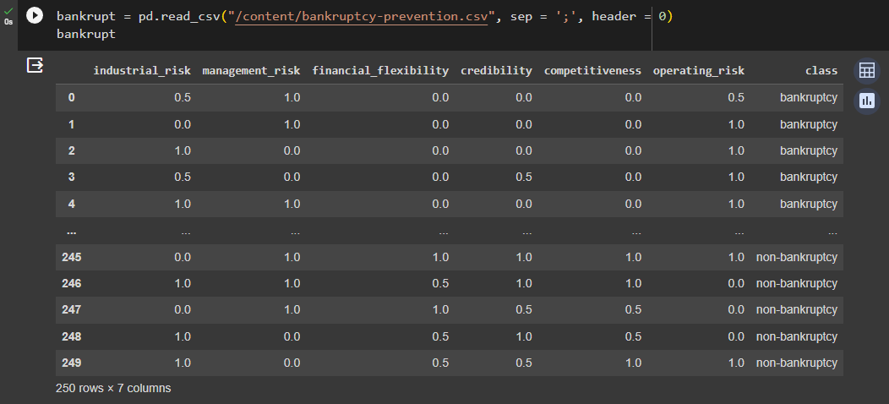
Exploratory Data Analysis (EDA)

Slide 6
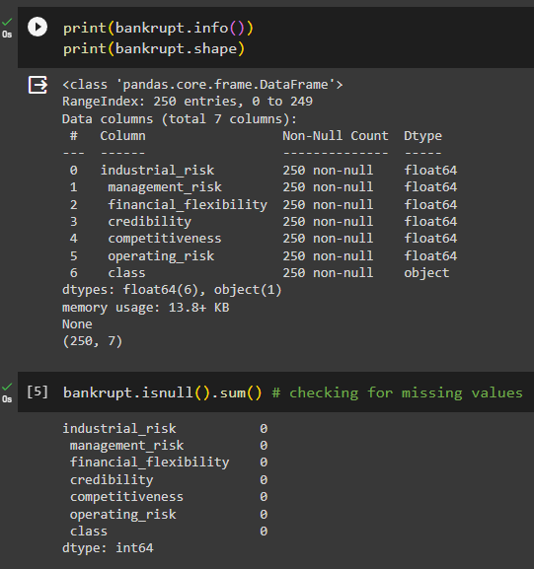
EDA
First we check for any missing values or any patterns in the dataset.

Slide 7
EDA
We create a new data frame and keep all the same values in the new data frame from the same dataset.
Then we create a new column of class and assign 1 values to all and change the target variables for bankruptcy to 0 and non-bankruptcy to 1.
Finally we delete the extra class column and start with the visualizations

Slide 8
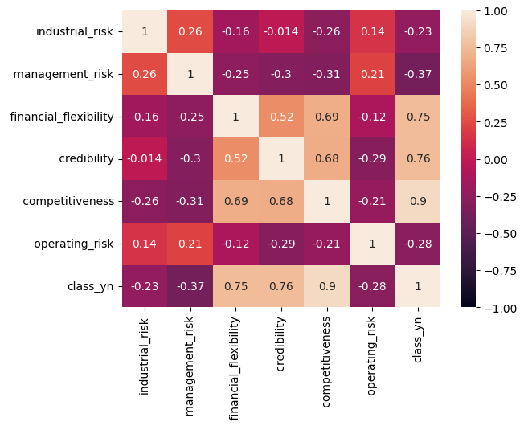
EDA (Visualizations)
Correlation matrix (Heatmap)

Slide 9
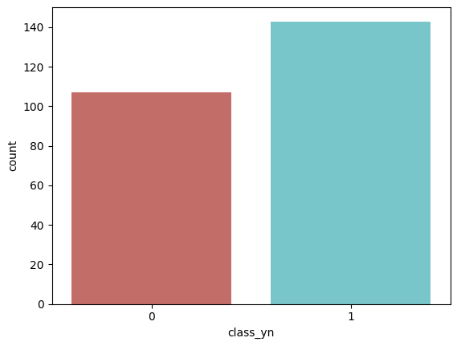
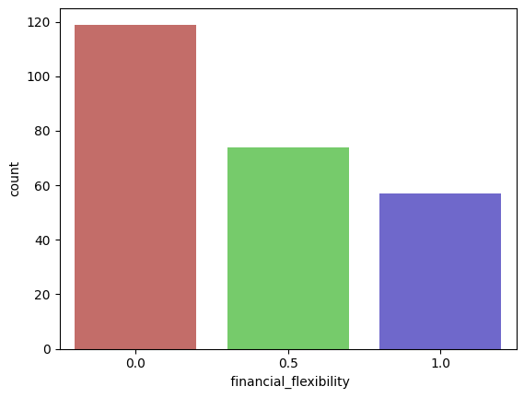
First graph shows the count of bankrupt and no-bankrupt companies.
Second graph shows the count of bankrupt and non-bankrupt companies based on the feature financial flexibility.

Slide 10
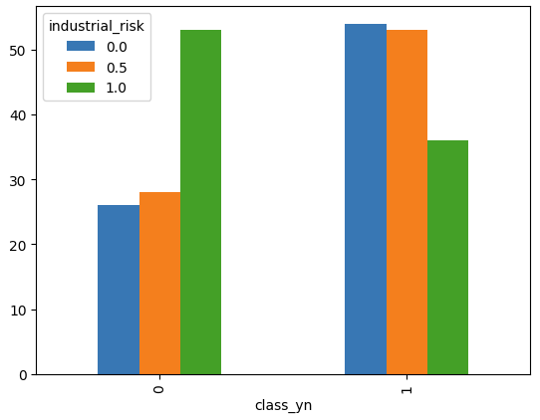
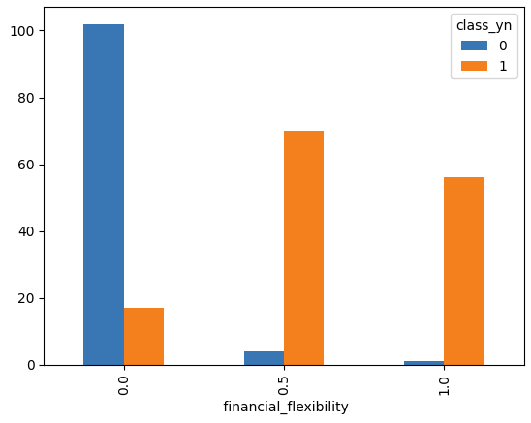
Here first graph shows the count of bankrupt and non-bankrupt companies based on their industrial risk feature.
Second graph shows the number of bankrupt and non-bankrupt companies in each financial flexibility category. The plot shows that there are more bankrupt companies in low financial flexibility than in the high financial flexibility category. This shows that the financial flexibility is a protective factor against bankruptcy.

Slide 11
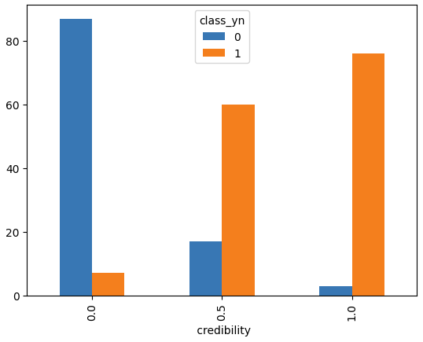
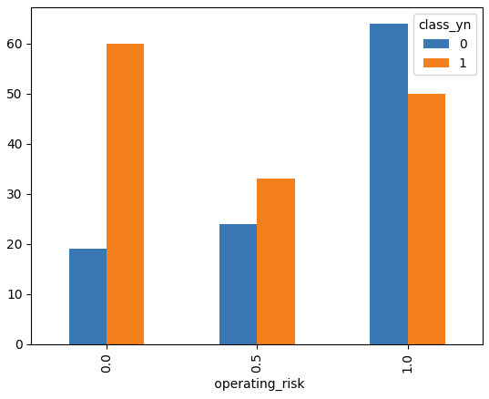
Here first graph shows the number bankrupt and non-bankrupt companies based on each credibility feature. This plot shows that there are more bankrupt companies in the low credibility category than in the high credibility category. This is also a protective factor against bankruptcy.
Second graph shows there are more bankrupt companies in the high operating risk category than in low operating risk category.

Slide 12
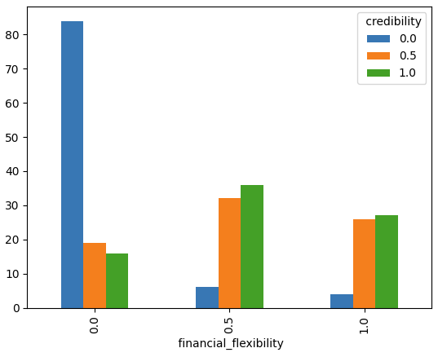
This graph shows the number of companies with high and low credibility in each financial flexibility category. This plot shows that there are more non-bankrupt companies with high credibility than bankrupt companies with high credibility.

Slide 13
Thank you

